Slide 1
دوره‌ی پایتون- جنگو
بوت‌کمپ ۵۱
مدرس: میمنت جلیلیان
مربی: سارا قانعی

Slide 2
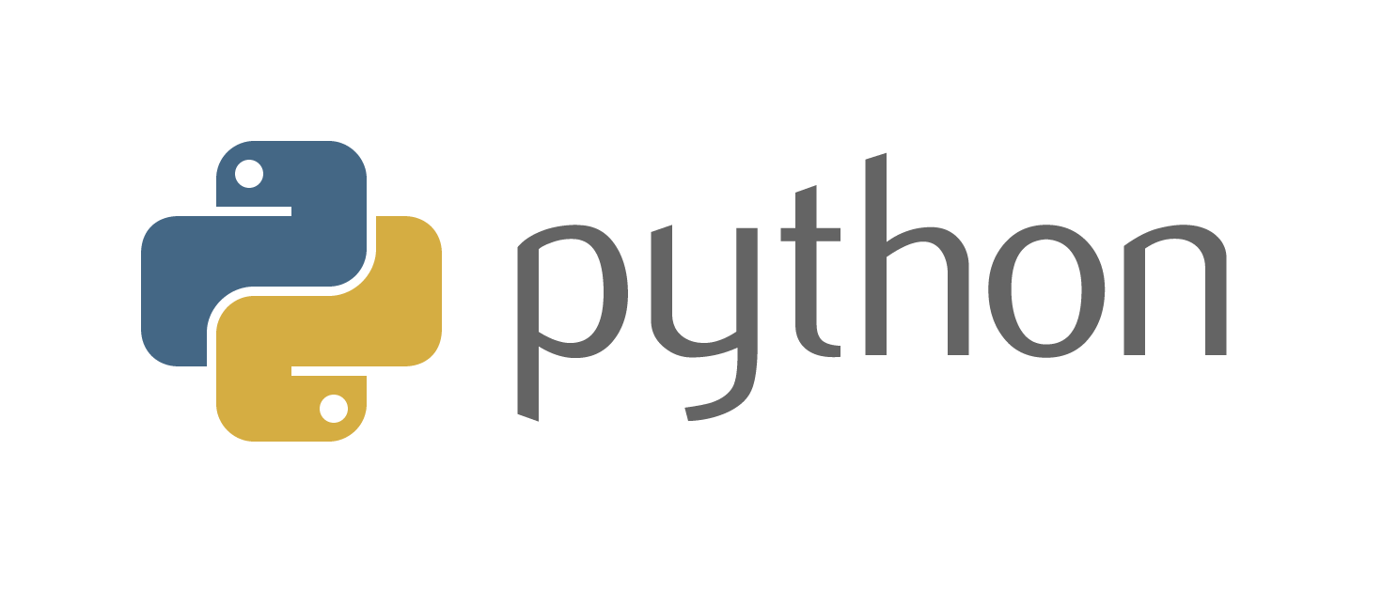
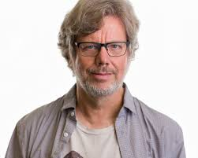
About Python
Development started in the 1980’s by Guido van Rossum
Now it's widely spread
Free, Open Source
Easy to learn
Interpreted
high level
General purpose
Cross-platform
Large standard library and active community

Slide 3
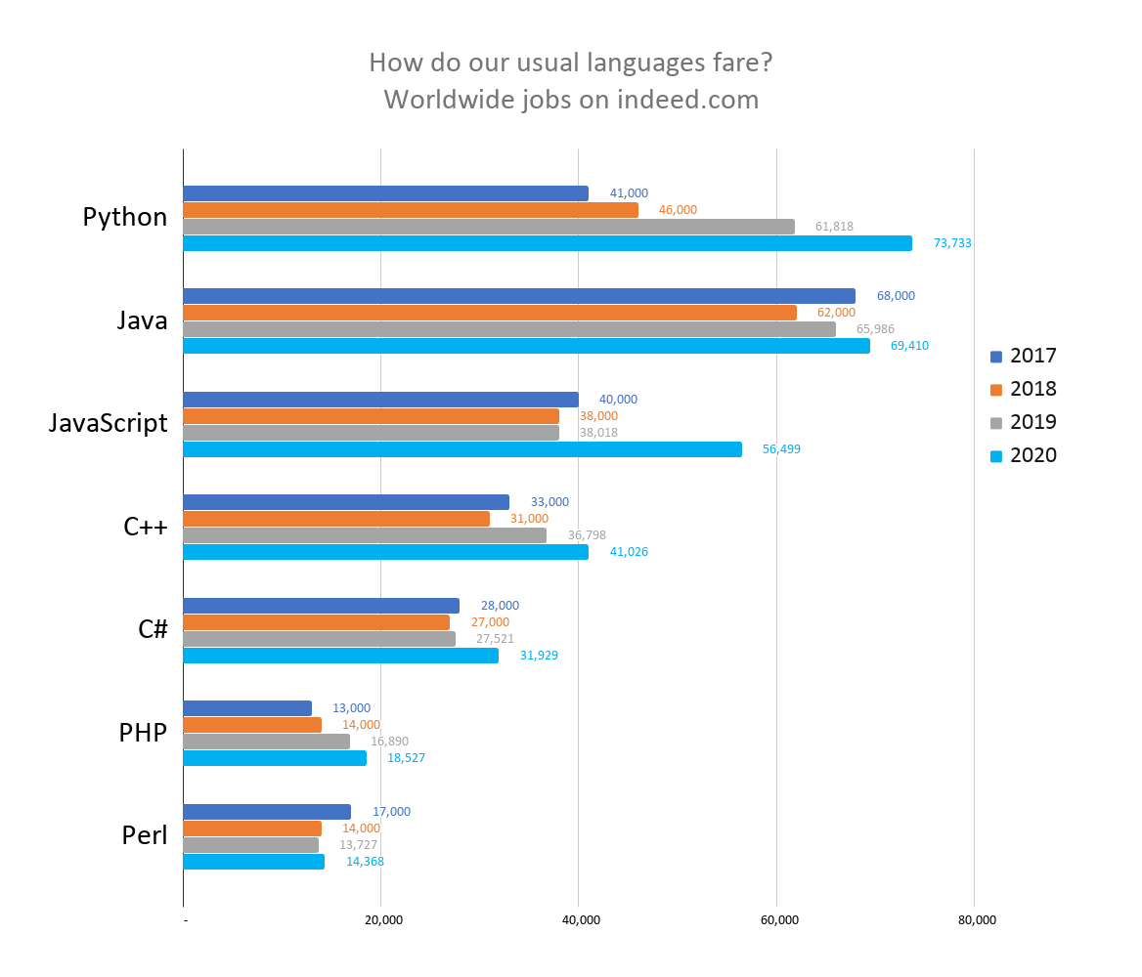
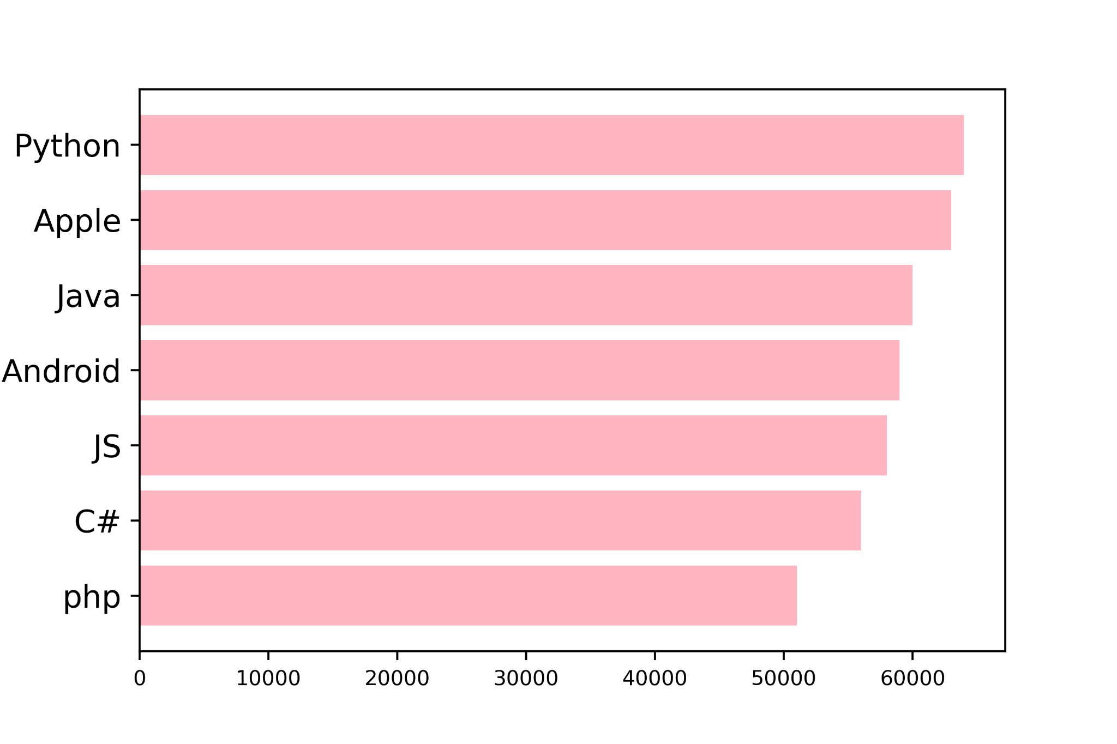
Python in Market
Average Salary in Iran based on Jobinja Website

Slide 4
Philosophy
Beautiful is better than ugly.
Explicit is better than implicit.
Simple is better than complex.
Complex is better than complicated.
Flat is better than nested.
Sparse is better than dense.
Readability counts.
Special cases aren't special enough to break the rules.
Although practicality beats purity.
Errors should never pass silently.
Unless explicitly silenced.
In the face of ambiguity, refuse the temptation to guess.
There should be one-- and preferably only one --obvious way to do it.
Although that way may not be obvious at first unless you're Dutch.
Now is better than never.
Although never is often better than right now.
If the implementation is hard to explain, it's a bad idea.
If the implementation is easy to explain, it may be a good idea.
Namespaces are one honking great idea -- let's do more of those!

Slide 5
Course Structure
Sessions:
Sunday 18-21
Thursday- Friday : 9-12 | 14-17
Projects:
One Python project
One Django Project
One Complete Django Project Setup on OS
Homeworks:
Weekly
Delay penalty: -10% daily ( up to 5 days)
After 5 days: -50%

Slide 6
RoadMap
Python
11 Days
Django
16 Days
Frontend
4 Days
OS
DataBase
Web Server
Git
Network
9 Days

Slide 7
Resources
Stanford Python Course
MIT Python Course
Tutorialspoint python course
...

Slide 8
Let's Start!

Slide 9
First things first
Do not hesitate to ask!
If something is not clear, stop me and ask.
try to code with me
Coding is all about trial and error.
Don't be afraid of it.
Error messages aren't scary, they are useful.

Slide 10
Getting Started
Install Python (https://www.python.org/downloads/)
Somewhere to write code
IDE (Pycharm, Visual Studio, Spyder,Jupyter Notebook,...)
Notepad, Notepad++, Sublime,...
Online Python shells (https://www.python.org/shell/)

Slide 11
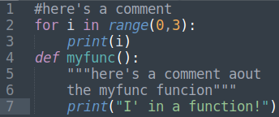
Some fundamentals
Whitespace is significant in Python. Where other languages may use {} or (), Python uses indentation to denote code blocks.
Comments
Single-line comments denoted by #.
Multi-line comments begin and end with three “s.
Typically, multi-line comments are meant for documentation.
Comments should express information that cannot be expressed
in code – do not restate code.

Slide 12
Python typing
Python is a strongly, dynamically typed language.
Strong Typing
Obviously, Python isn’t performing static type checking, but it does prevent mixing operations between mismatched types.
Explicit conversions are required in order to mix types.
Example: 2 + “four” not going to fly
Dynamic Typing
All type checking is done at runtime.
No need to declare a variable or give it a type before use.

Slide 13
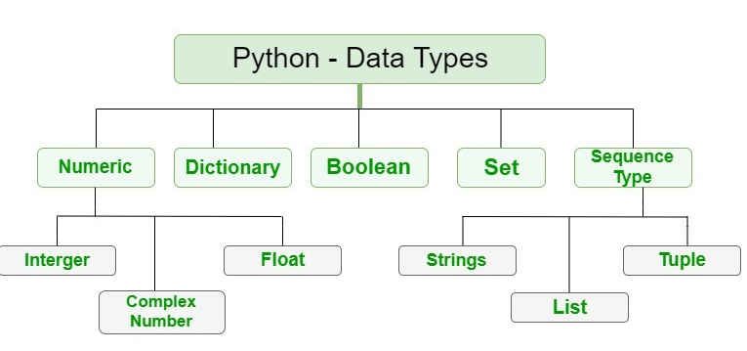
Data types

Slide 14
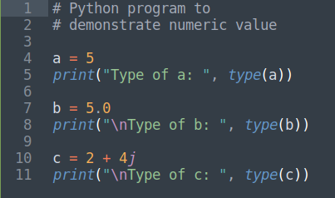
Numeric types
Numeric
int: equivalent to C’s long int in 2.x but unlimited in 3.x.
float
complex

Slide 15
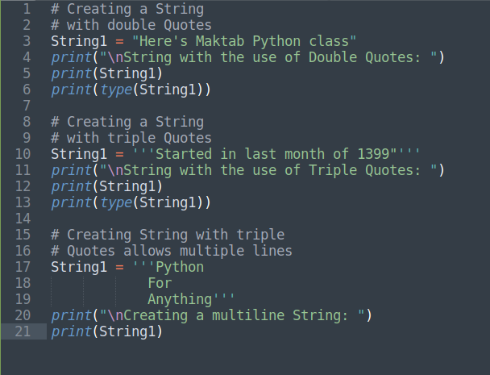
String type
Accessing elements[]
.append()
len()
.upper()
.lower()

Slide 16
Operations in Strings
upper()
lower()
capitalize()
count(s)
find(s)
rfind(s)
index(s)
strip(), lstrip(), rstrip()
replace(a, b)
expandtabs()
split()
join()
center(), ljust(), rjust()

Slide 17
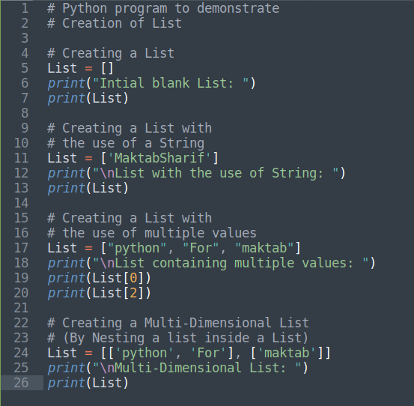
List type
create
list slicing
append()
extend()
pop()
insert()

Slide 18
Operations in Lists
append()
insert
index
count
sort
reverse
remove
pop
extend
Indexing e.g., L[i]
Slicing e.g., L[1:5]
Concatenation e.g., L + L
Repetition e.g., L * 5
Membership test e.g., ‘a’ in L
Length e.g., len(L)

Slide 19
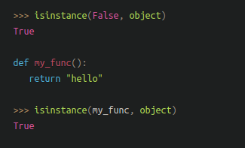
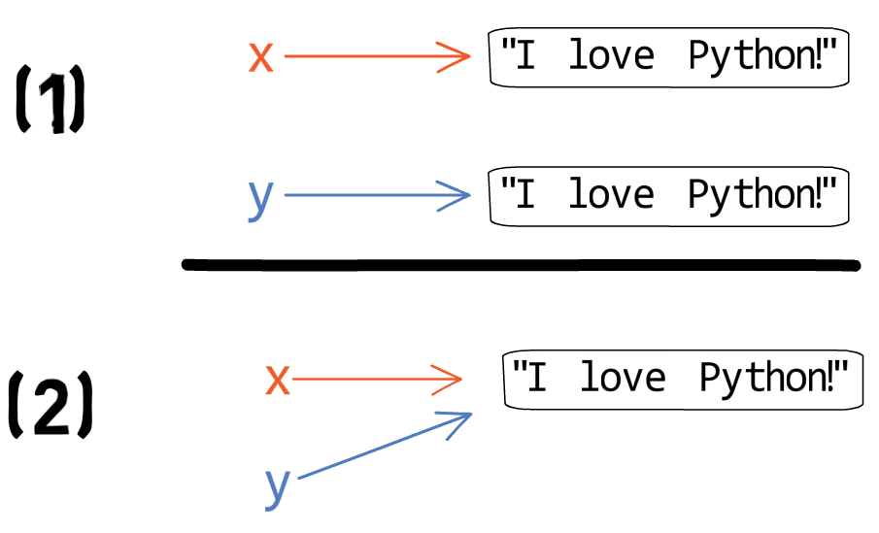

Everything is an Object
everything is an object:
integer,function,...
every object has:
identity: never changes once it has been created
name
value
try these:
id()
x == y
x is y

Slide 20
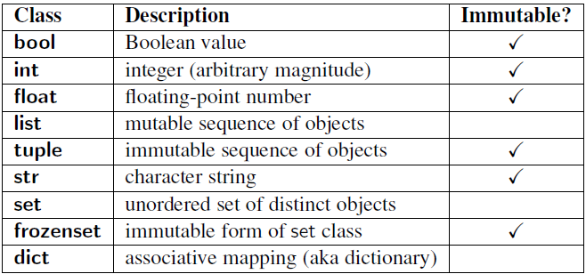
Mutable vs. Immutable
Mutable:
Value can be changed after creation
Immutable:
Value can NOT be changed after creation

Slide 21
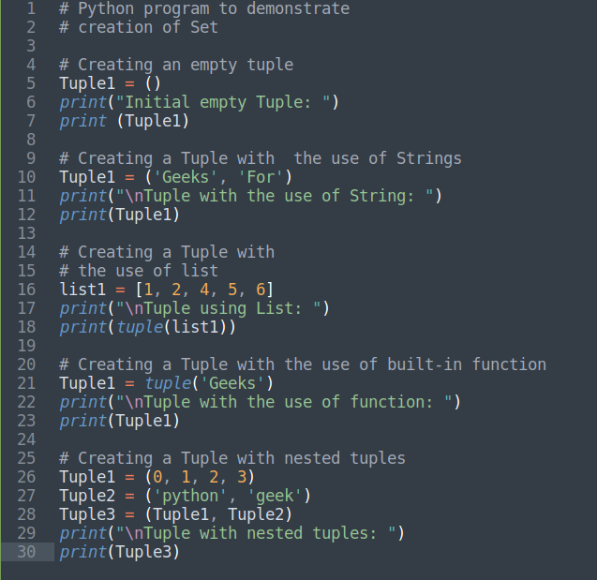
Tuple type
like lists, but immutable

Slide 22

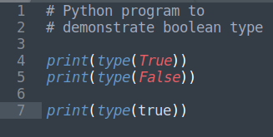
Boolean type
True
or
False
That's the question!

Slide 23
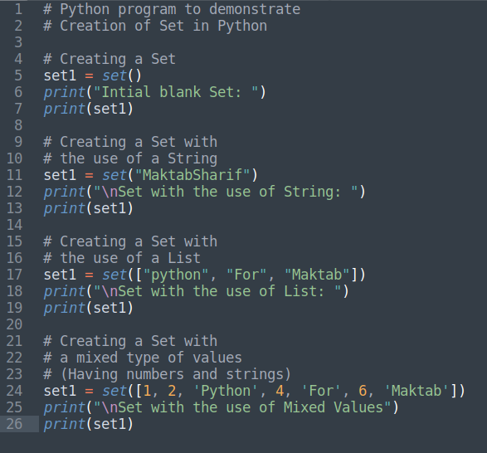
Set type

Slide 24
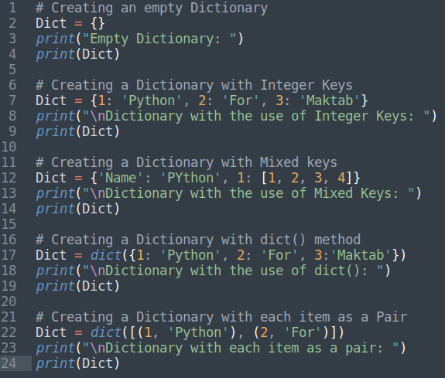
Dictionary type

Slide 25
Methods in Dictionaries
keys()
values()
items()
has_key(key)
clear()
copy()
get(key[,x])
setdefault(key[,x])
update(D)
popitem()

Slide 26
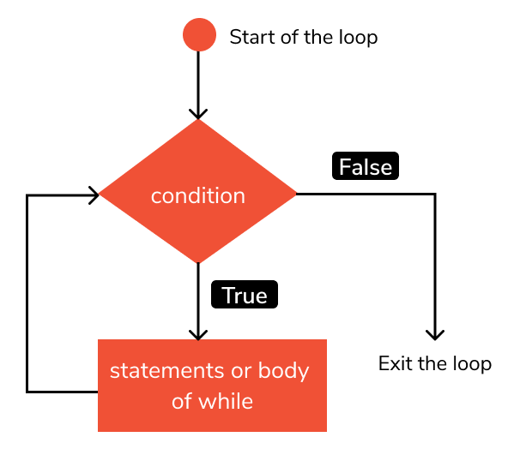
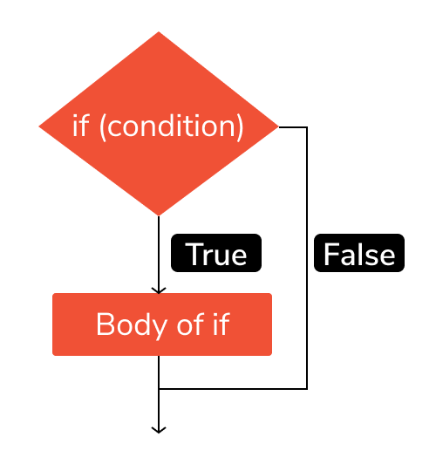
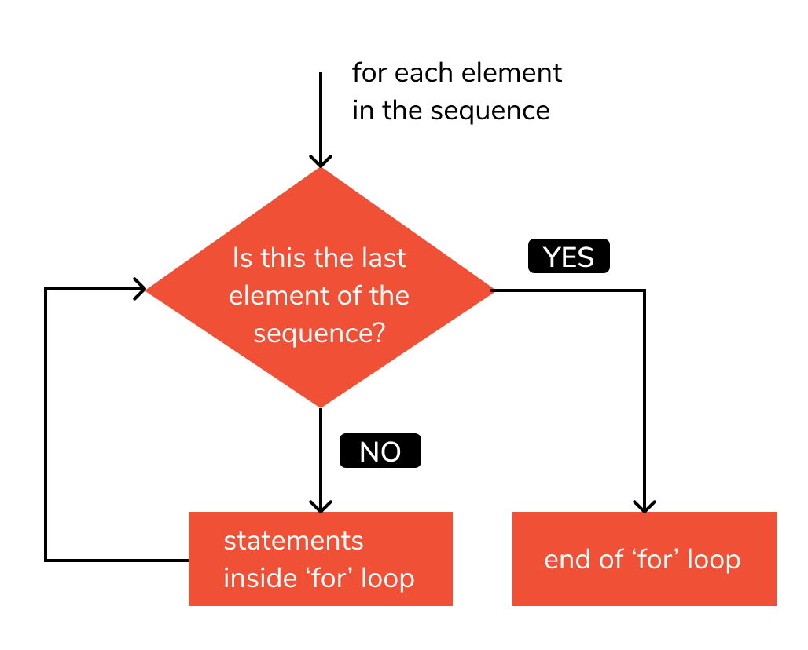
Control flow tools
conditions
If/elif/else
Iterations
for loops
while loops

Slide 27
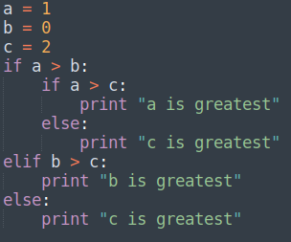
If/elif/else
if expression:
statements
elif expression:
statements
else:
statements

Slide 28
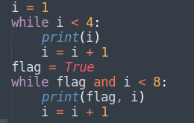
While
while expression:
statements
statements: one or more lines of Python code.
conditional expression: may be any expression, where any non-zero value is true.
The loop iterates while the expression is true.

Slide 29
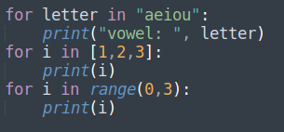
For
for var in sequence:
statements
If a sequence contains an expression list, it is evaluated first. Then, the first item in the sequence is assigned to the iterating variable var.
For loops may be nested with other control flow tools such as while loops and if statements.

Slide 30
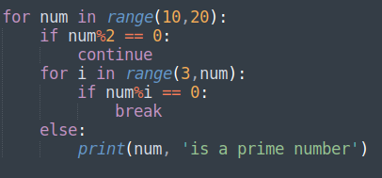
In case you need...
Statements provided for manipulating loop structures.
break: terminates the current loop.
continue: immediately begin the next iteration of the loop.
pass: do nothing. Use when a statement is required syntactically.
else: represents a set of statements that should execute when a loop terminates.

Slide 31

Time to Dive into
a real Problem!

Slide 32

Help Persian Trail Runners
Register runners:
get their name
give them a number(start from zero)
prevent duplicates
print the names alphabetically sorted
Submit records:
get distance for each runner
print 3 top runners

